Slide 1
Introduction to Big Data
March 2023
Created By:
Rajesh Shendre
Senior Data Engineer

Slide 2
Agenda
What is Big-Data.
Big data facts.
Sources of Big data Generation.
Big Data characteristics.
Data classification.
Big Data in industry.
Big data use cases.
Why is Data so important?
Data-Driven Decision Making.
Extract Transfrom Load
Data Lake, Data warehouse & Data mart
Lakehouse & Data mesh
Difference between Data Lake, Data warehouse & Data lakehouse

Slide 3
Agenda
Processing Big Data using Hadoop Eco system
Hadoop Eco system
Stages of Big data processing

Slide 4
What is Big Data?
Big data is a collection of data that is huge in volume yet growing exponentially with time.
Data is so large and complex that it becomes difficult to process using traditional database management tools or traditional data processing applications.
The challenges include capture, curation, storage, search, sharing, transfer, analysis, and visualization.

Slide 5
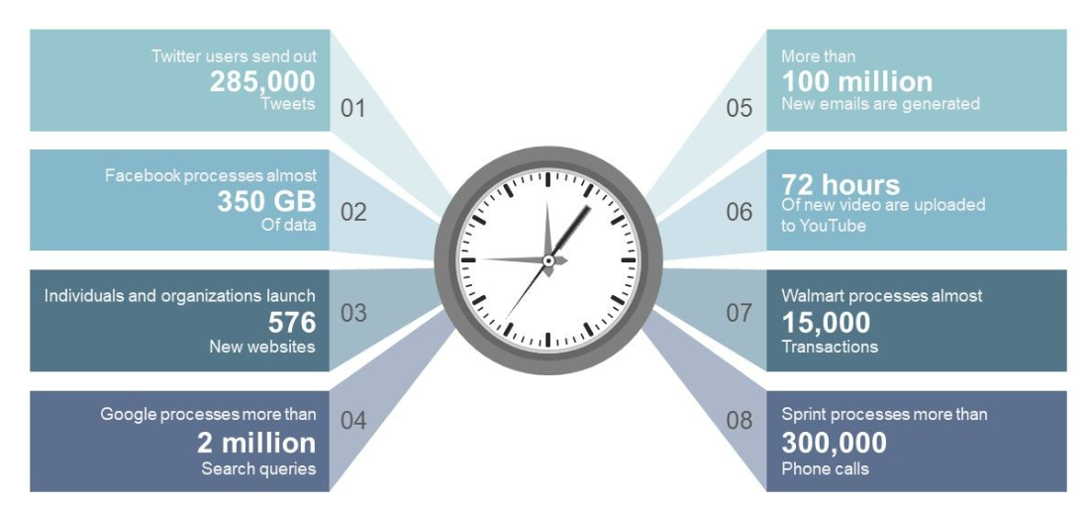
Big Data Facts- How Big is Big Data

Slide 6
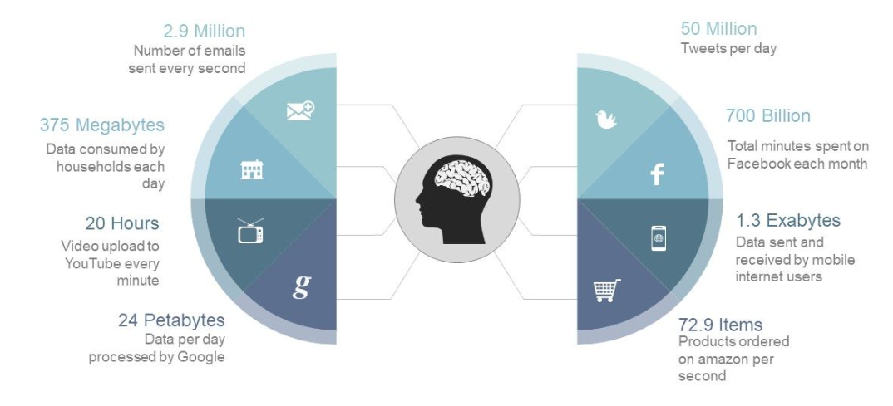
Big Data Facts- How Big is Big Data

Slide 7
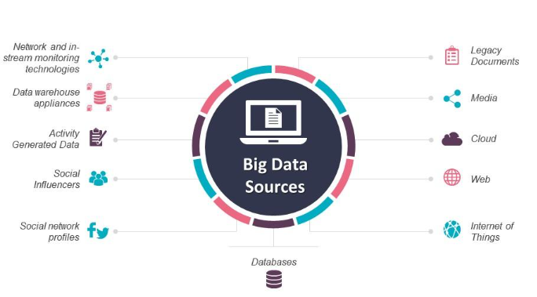
Sources of Big Data Generation

Slide 8
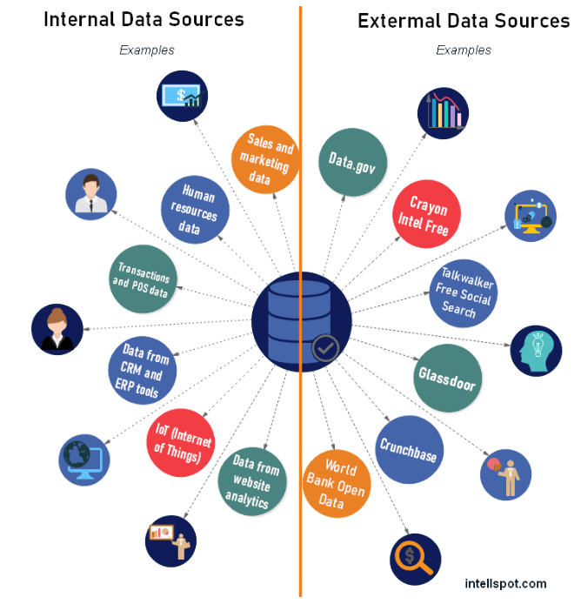
Sources of Big Data Generation
Internal sources of data
Information within the company
CRM system, ERP system
Sales reports, business documents
Customer orders etc.
External sources of data
Government statistics
Media channels
Regional economic reports

Slide 9
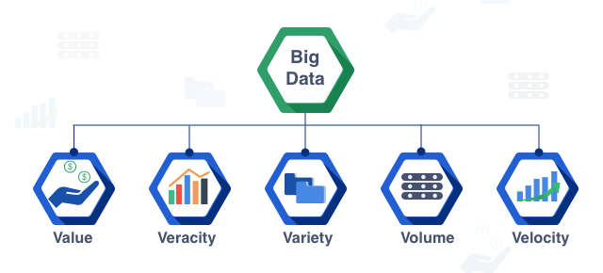
Big Data characteristics
There are 5V’s that are vital for classifying data as Big Data.

Slide 10
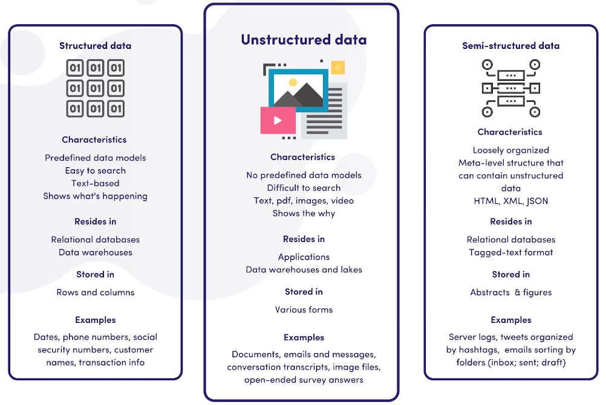
Data Classification
Depending on its format data is classified into three categories
Data can be either structured, semi structured and unstructured.

Slide 11
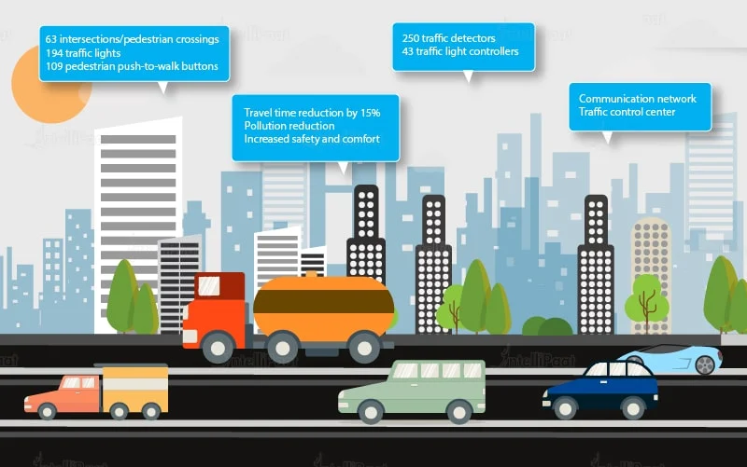
Big Data in Industry
Transportation Industry
Big data has been
used in various ways to
make transportation more
efficient and easy.

Slide 12
Big Data in Industry continues..
Following are some of the areas where big data contributes to transportation.
Route planning: Big data can be used to understand and estimate users’ needs on different routes and multiple modes of transportation and then utilize route planning to reduce their wait time.
Congestion management and traffic control: Using big data, real-time estimation of congestion and traffic patterns is now possible. For example, people are using Google Maps to locate the least traffic-prone routes.
The level of traffic: Using the real-time processing of big data and predictive analysis to identify accident-prone areas can help reduce accidents and increase the safety level of traffic.

Slide 13

Big data use case – Uber.
Let’s take Uber as an example here. Uber generates and uses a huge amount of data regarding drivers, their vehicles, locations, every trip from every vehicle, etc. All this data is analysed and then used to predict supply, demand, location of drivers, and fares that will be set for every trip

Slide 14
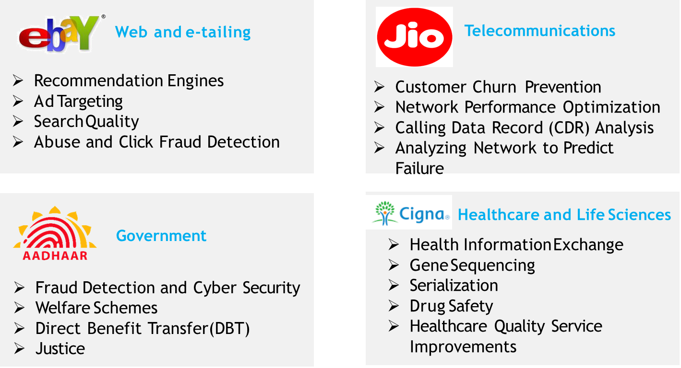
Some Other use-cases of Big data.

Slide 15
Why Data is so important?
Data is Knowledge : Data will help you to identify high-performing programs, service areas, and people
Make Informed Decisions : Good data provides indisputable evidence. It will avoid having assumptions, or abstract observation which might lead to wasted resources.
Get The Results You Want : Collecting data will allow you to determine how well your solution is performing and you can tweak your approach if needed.
Stop The Guessing Game : Data will help you explain (both good and bad) decisions to your stakeholders.
Know What You Are Doing Well : Data allows you to replicate areas of strength across your organization.

Slide 16
Why is Data so important?
Stop Molehills From Turning Into Mountains: By utilizing data organizations can respond to challenges before they become full-blown crisis. Effective quality monitoring will allow them to be proactive and will support the organization to maintain best practices over time.
Make The Most Of Your Money: With the shift from funding that is based on services provided to funding that is based on outcomes achieved, it is increasingly important for organizations to implement evidence-based practice and develop systems to collect and analyse data.
Keep Track Of It All: Good data allows organizations to establish baselines, benchmarks, and goals to keep moving forward.

Slide 17
Data-Driven Decision Making.
Data-driven decision making is defined as using facts, metrics, and data to guide strategic business decisions that align with goals, objectives, and initiatives.
Data driven decision making is a process that involves analysing collected data and drawing insights to benefit a business or organization.
Data driven decision making allows for a better understanding of business needs by leveraging real, verified data, instead of just making assumptions.
Rather taking a shot in the dark we can work towards business goals by leveraging analysed data.

Slide 18
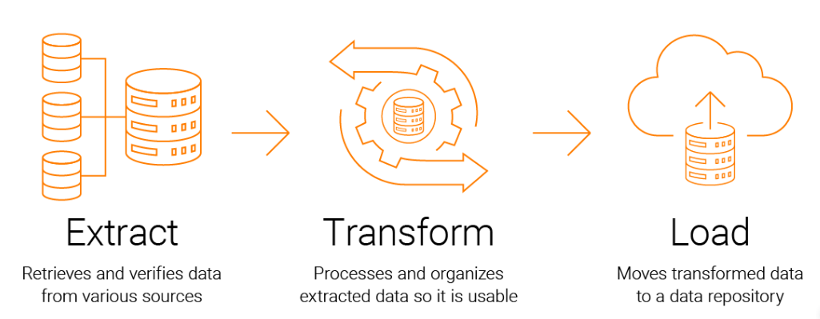
What is ETL- Extract, Transform and Load?
It is a data integration process that combines data from multiple data sources into a single, consistent data store that is loaded into a data warehouse or other target system.
ETL involves three main steps.
Extract
Transform
Load

Slide 19
ETL Continues..
Extract
During data extraction, raw data is copied or exported from source locations to a staging area.
Data can be extracted from a variety of data sources, which can be structured or unstructured.
Sources can be SQL or NoSQL servers,CRM and ERP systems, Flat files, Email, Web pages​.
Transform
The raw data undergoes data processing. Here, the data is transformed and consolidated for its intended analytical use case.
It includes Filtering, cleansing, de-duplicating, validating, and authenticating the data.
Performing calculations, translations, or summarizations based on the raw data.
Load
Finally, the transformed data is loaded into the target system, such as a data warehouse or a data lake.
This step involves mapping the data to the target schema and loading it into the target database.​
​
​

Slide 20
Data Lake, Data warehouse & Data mart
Data Lake
It is central storage repository used to store a vast amount of raw, granular data in its native format. It is a single store repository containing structured data, semi-structured data, and unstructured data.
Data warehouse
It is centralized repository of data that is specifically designed to support business intelligence (BI) activities such as reporting and analysis. It typically stores data from multiple sources, which is then transformed into a consistent format for analysis.
Data mart
It is a subset of a data warehouse that is designed to serve a specific business requirement. It contains a subset of data from the larger data warehouse, which is tailored to the needs of the specific business unit.

Slide 21
Lakehouse & Data mesh
Lakehouse
It is a new concept that combines the best features of both data lakes and data warehouses.
It’s a new type of big data storage architecture for organized, semi-structured, and/or unstructured data.
Data can be stored in a single location and is suitable for ML and BI, as well as data streaming.
Added features include version history, ACID transactions, and data governance, features that are typical in a data warehouse, but are generally lacking in a data lake.
Data mesh
A data mesh is a decentralized data architecture that organizes data by a specific business domain providing more ownership to the producers of a given dataset.

Slide 22
Difference between Data Lake, Data warehouse & Data lakehouse
Features | Data lakes | Data warehouses | Data lakehouses
Type of data | Semi-structured and unstructured data | Structured data | Structured, semi-structured, and unstructured data
Purpose | Applicable for machine learning and artificial intelligence tasks | Best for data analytics and BI, but limited to particular problem-solving | Flexible storage, can be used for research, data analytics and ML
ACID compliance | Non-ACID compliant: data integrity issues | ACID-compliant: ensures the integrity of data | ACID-compliant: ensures consistency of data read and written by multiple sources
Cost of storage | Cost-effective, fast, flexible | Expensive, time-consuming | Cost-effective, easy, allows for a lot of flexibility, reduced data duplication

Slide 23
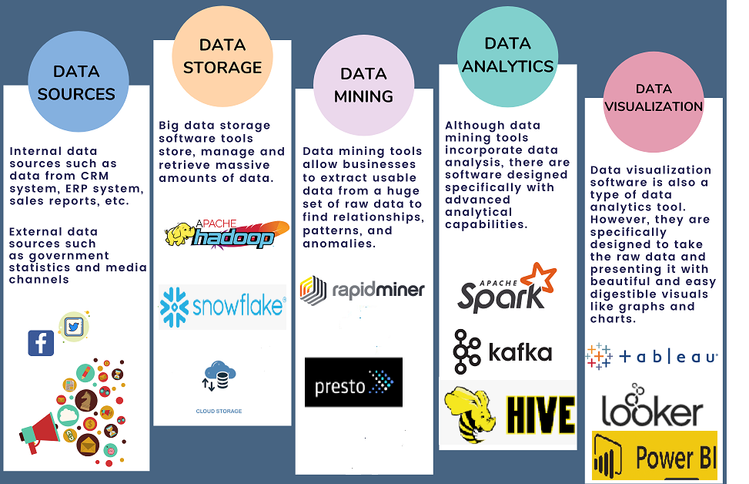
Technologies for Processing Big Data
It is a combination of techniques, tools, and knowledge for collecting and analyzing data.
The purpose is to gain insights that lead to better decisions and improved business results.

Slide 24
Technologies for Processing Big Data
Data Source: It is a location where data is stored and managed. It can be a database, a file, an API, a spreadsheet, or any other system that stores and provides access to data. Data sources can be internal or external to an organization
Data Storage: It is made up of infrastructure that allows users to store the data so that it is convenient to access. Commonly used tools are Apache Hadoop, snowflake and different Cloud storage.
Data mining : It extracts the useful patterns and trends from the raw data. Big data technologies such as Rapidminer and Presto can turn unstructured and structured data into usable information.

Slide 25
Technologies for Processing Big Data
Data Analytics: Technologies used to clean and transform data into information that can be used to drive business decisions. Commonly used tools are Apache Spark, Kafka and Hive.
Data Visualization : Technologies can be used to create stunning visualizations from the data to tell an impactful story with a simple graph. Some of technologies used are Looker, tableau and Power BI.

Slide 26
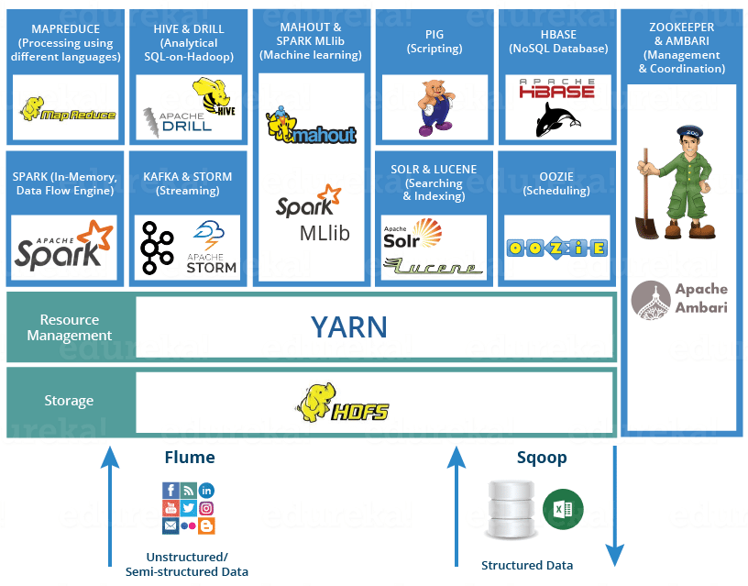
Processing Big Data using Hadoop Eco system

Slide 27
Hadoop Eco system
The Hadoop ecosystem is a collection of tools, frameworks, and technologies that are built around the Hadoop distributed computing platform. Hadoop is an open-source framework that provides a scalable and fault-tolerant way to store and process large volumes of data.
The key components of the Hadoop ecosystem include:
Hadoop Distributed File System (HDFS): A distributed file system that allows data to be stored across multiple nodes in a Hadoop cluster.
YARN: A resource management system that allows multiple applications to run simultaneously on a Hadoop cluster.
MapReduce: A programming model for processing large datasets in parallel across a Hadoop cluster.

Slide 28
Hadoop Eco system continues..
Apache Pig: A high-level platform for creating MapReduce programs used for analyzing large datasets.
Apache Drill: It is an open-source distributed SQL query engine that allows users to query various structured and semi-structured data sources using SQL queries.
Apache Hive: A data warehousing system that allows SQL-like queries to be run against data stored in Hadoop.
Apache Spark: A fast and general-purpose cluster computing system that provides an alternative to MapReduce for processing large datasets.
Apache Flume: A tool for efficiently collecting, aggregating, and moving large amounts of log data from various sources to Hadoop.

Slide 29
Hadoop Eco system continues..
Apache Sqoop: A tool for transferring data between Hadoop and relational databases.
Apache HBase: A NoSQL database that provides real-time access to large datasets.
Apache Storm: It is an open-source distributed stream processing system used for real-time data processing. It was developed at BackType (now part of Twitter) and later donated to the Apache Software Foundation. Storm allows developers to create complex data processing pipelines using a simple programming model based on streams of data.
Apache Kafka: It is an open-source distributed streaming platform used for building real-time data pipelines and streaming applications. It was developed at LinkedIn and later donated to the Apache Software Foundation. Kafka is designed to handle high volumes of data in real-time and can be used for a wide range of use cases, such as messaging, streaming data processing, and real-time analytics.

Slide 30
Hadoop Eco system continues..
Apache Mahout: Mahout provides a collection of machine learning algorithms, including clustering, classification, collaborative filtering, and recommendation algorithms. These algorithms can be used to build intelligent applications such as personalized recommendations, customer segmentation, fraud detection, and image recognition.
Apache Spark MLlib is a machine learning library developed by the Apache Software Foundation, designed to provide scalable and distributed machine learning algorithms. It is built on top of Apache Spark, a fast and general-purpose cluster computing system, and provides a high-level API for building machine learning pipelines.
Apache ZooKeeper: A centralized service for maintaining configuration information, naming and synchronization of distributed systems.

Slide 31
Hadoop Eco system continues..
Apache Lucene : Lucene provides a set of powerful search capabilities, including text indexing, searching, and highlighting. It can be used to build search applications that can search large volumes of text data quickly and efficiently. Lucene uses an inverted index data structure to store the indexed data, which allows for fast and efficient searches.
Apache Solr: Apache Solr is an open-source search platform built on top of the Apache Lucene.Solr provides a wide range of search capabilities, including full-text search, faceted search, and geospatial search. It also provides tools for document indexing, searching, and relevance ranking.
Apache Ambari is an open-source management platform. It is designed to simplify the installation, configuration, and management of Apache Hadoop clusters. It provides a web-based interface for managing Hadoop clusters and their associated components, such as Apache HBase, Apache Hive, and Apache Spark.

Slide 32
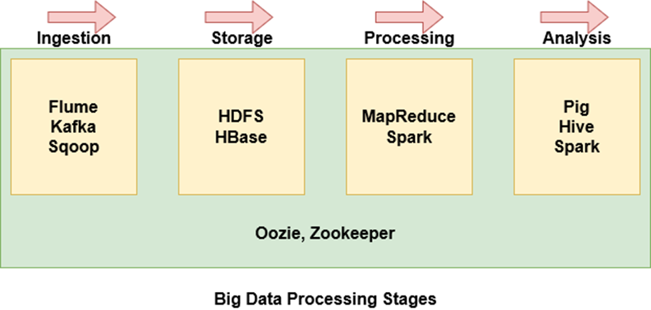
Stages of Big Data Processing
Flume, Kafka, and Sqoop are used to ingest data from external sources into HDFS
HDFS is the storage unit of Hadoop. Even data imported from HBase is stored over HDFS
MapReduce and Spark are used to process the data on HDFS and perform various tasks
Pig, Hive, and Spark are used to analyse the data
Oozie helps to schedule tasks. Since it works with various platforms, it is used throughout the stages
Zookeeper synchronizes the cluster nodes and is used throughout the stages as well

Slide 33
Assignment
Difference between Mapreduce and Spark? Assessment - 5 points.
Difference between Flume and Sqoop? Assessment - 5 points.
For below use case
You have database of 3 employment websites. All resumes are in same template.
Your task is to make 3 sheet. First one to extract the important data, second one what transformation you perform, last one Entity Relationship model.
Source| Full Name | Address | Phone number | Email id | Skills | Experience | Projects Worked
Assessment - Every sheet will have 10 points.
10 points on what technologies you would use to process them.

